Slide 1
ACMA 231
Introduction

Slide 2
My Introduction
Professional Intro
  Linked In Profile: https://www.linkedin.com/in/himchan-jeong-b5b65110a/?originalSubdomain=ca
  Publication List: https://scholar.google.com/citations?user=WOqS7-8AAAAJ&hl=en
  Business Administration/Mathematics Major at Seoul National University
  Assistant Manager in DB Insurance (South Korea)
Personal Intro
  (Used to) play the guitar
  Love to eat, cook to eat, work out to eat

Slide 3
Required Materials
Note that you can download Office 365 for free as an SFU student.
R and RStudio is also free.
If possible, then I would encourage you to bring your own laptop as you can do practices along with the lectures during the class time.

Slide 4
ACMA 231
Why do actuaries need to know tools for data-driven decision making?

Slide 5
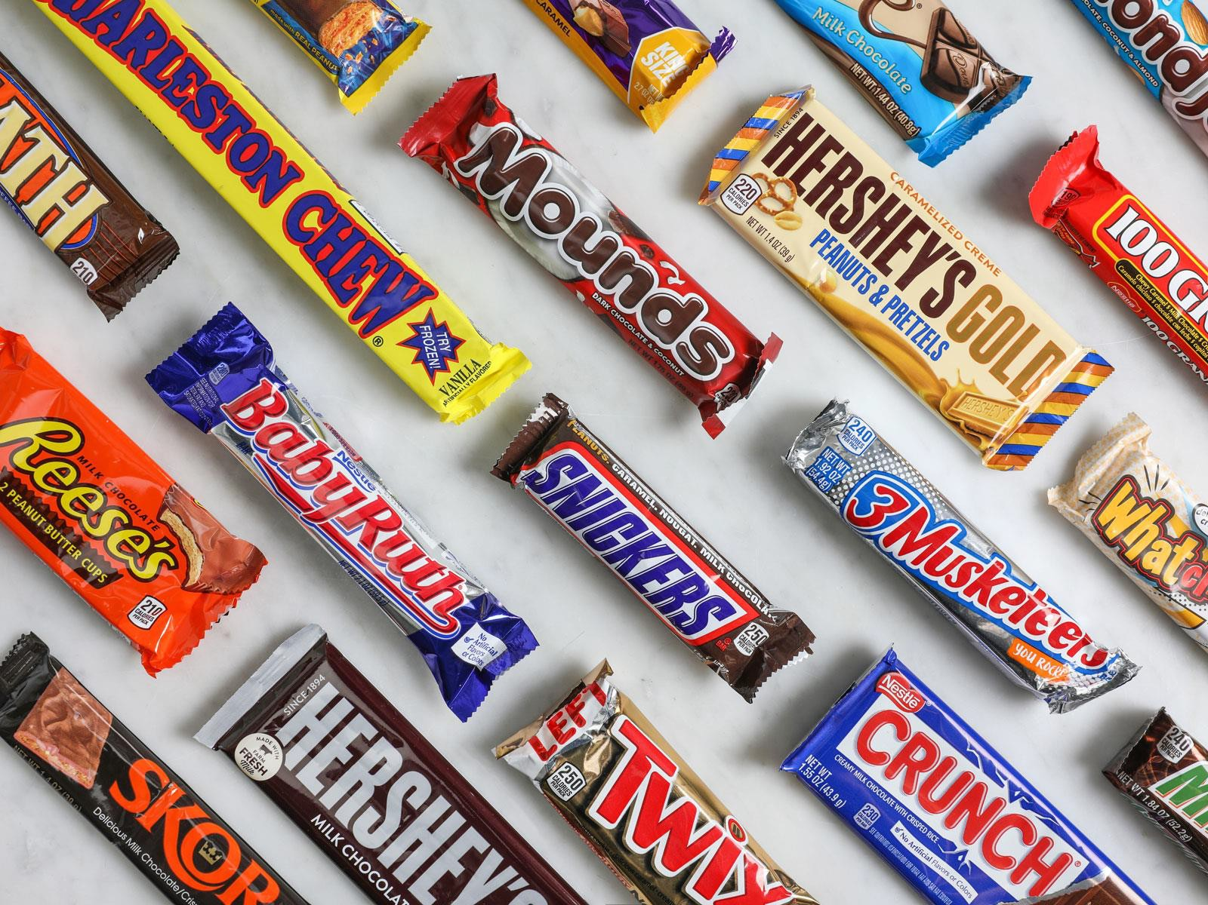
Candy bar companies sell candy bars!
What does an actuary do?
PRICE = COSTS + PROFIT
What are the costs to include when deciding on the price of a candy bar?
What do insurance companies sell?
A promise to indemnify the policyholder for future costs.
How do we price a product where all the costs are in the future?!? PRICE = COSTS + PROFIT
PREMIUM = EXPECTED FUTURE LOSSES + EXPECTED FUTURE
EXPENSES + DESIRED FUTURE PROFIT

Slide 6




What does an actuary do?
Your Premium is…
EXPECTED FUTURE COSTS
1
6

Slide 7

Ratemaking
Why do actuaries need to know programming?
Historical Data
Reserving
Use adjusted data to predict future costs
Planning
Adjust data to the future time period
Book
Management
Underwriting
Investment Strategy
Industry Benchmarks & Trends
Informed Assumptions
Trends & patterns from historical data
Claims Analytics
And more…

Slide 8






Why do actuaries need to know tools for data-driven decision making?
Historical Data
Smaller dataset, ad hoc analysis
Medium dataset, repeated processes
Large datasets, repeated processes, ad hoc analysis, predictive modeling, exploratory data analysis
Data prep, querying, filtering, etc.

Slide 9
Some remarks
While the course has been designed to primarily equip the actuarial students desired computational skills, these skills are in fact versatile and can be utilized in any profession with office works.
Note that MS Access is not available with the Office 365 license of SFU, so it is not covered in this class – in my understanding, MS Access is a version of SQL application with better visualization.
I think the most important reason that you need to learn Excel is…
To avoid unnecessary overtime work and sneak out from your workplace on time!

Slide 10
Suggestion for actuarial students
I would like to strongly suggest you to
  pass SOA Exam P (STAT 270 + a) - costs USD 260,
  pass SOA Exam FM (ACMA 201) - costs USD 260,
  and find a co-op position as an actuarial student.
After you have finished your first co-op, you can decide whether you would like to stay in the profession or look for another career. (Anyway, having one co-op opportunity does not hurt at all!)
It has been known that without one or two actuarial exams, it is not easy to secure an actuarial co-op (two is preferrable).

